Slide 1
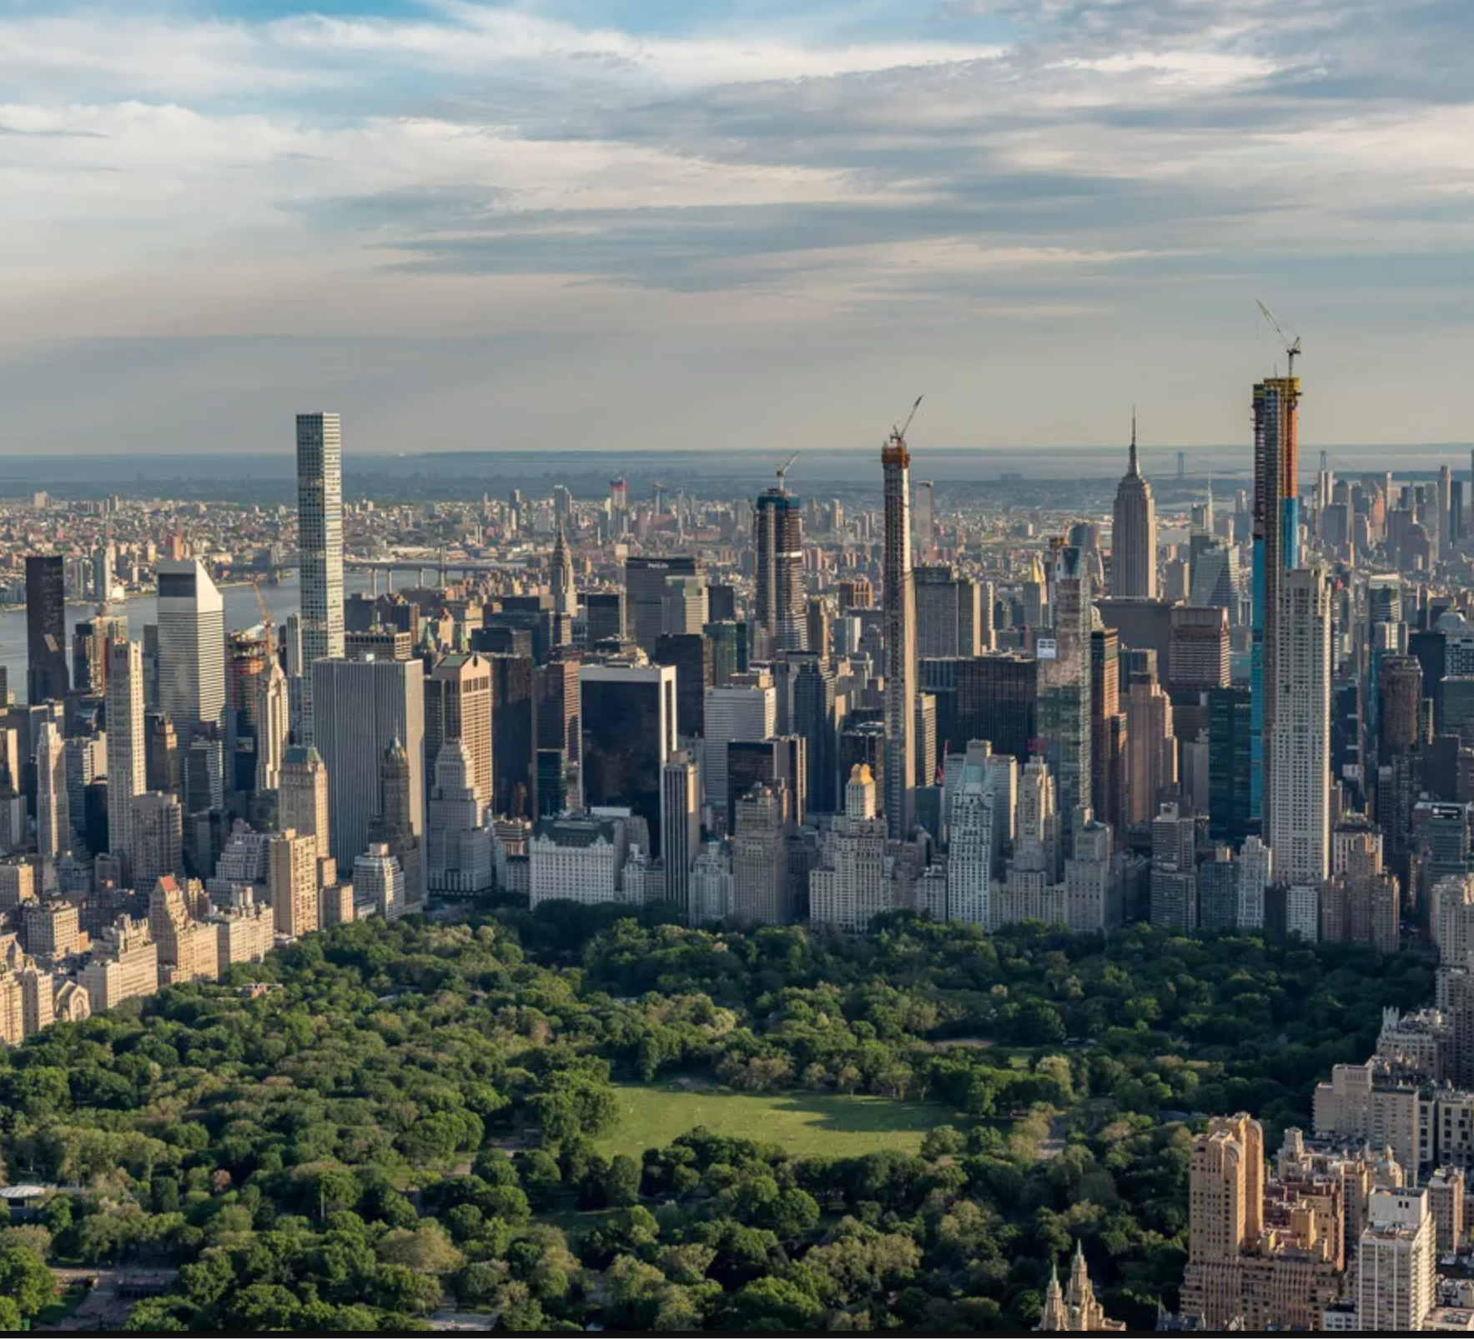
Citi Bike
Youssef Afify, Evan Colony, Khanh Duong, Jake Gandolfo & Safwaan Mir

Slide 2
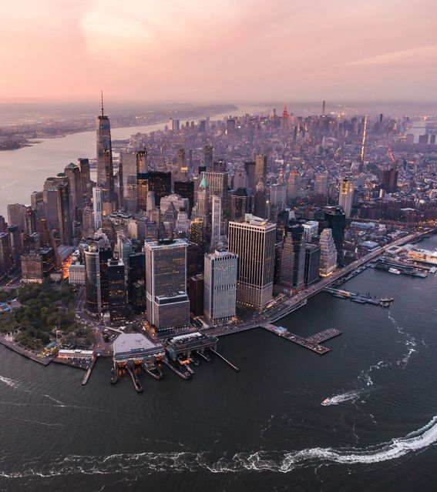
Agenda
Preliminary Analysis
Data Cleaning
Who Is Using Citi Bike?
Recommendation
Root Causes
Map Analysis
Ride Patterns
Weather
Holidays

Slide 3
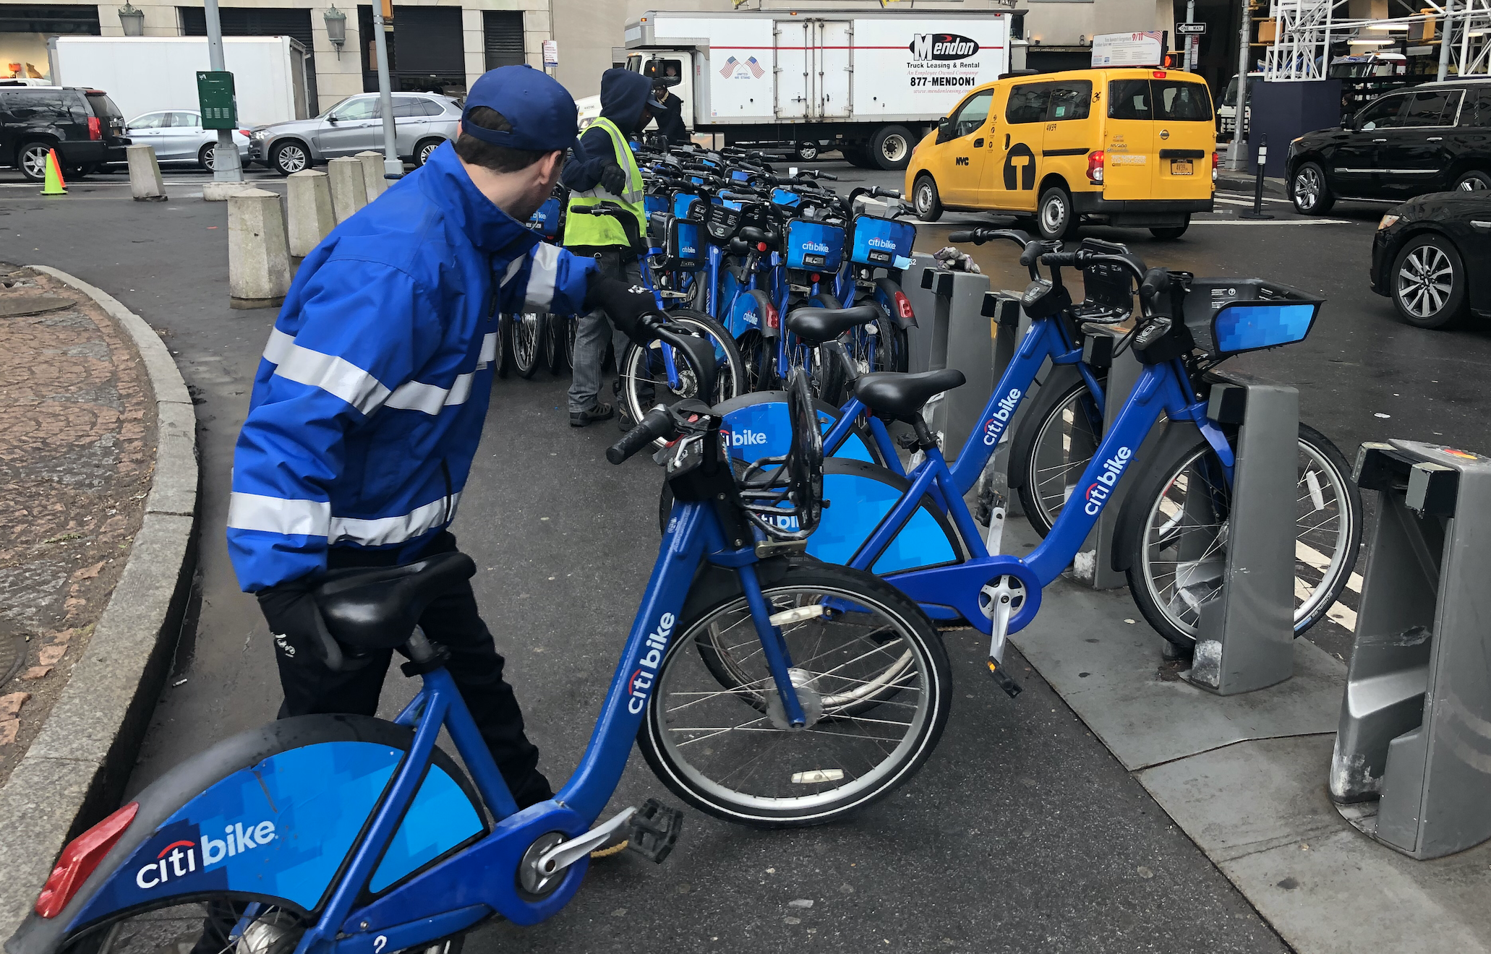
“80% of A Data Scientist’s Time is Spent cleaning the data, not analyzing it.”
Week Long Trips
145 Year Old Riders
Unknown Genders

Slide 4
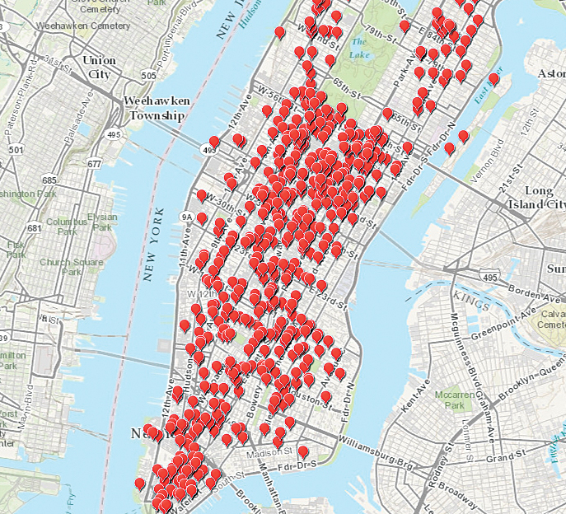
Problem: Asymmetric Ride distribution

Slide 5
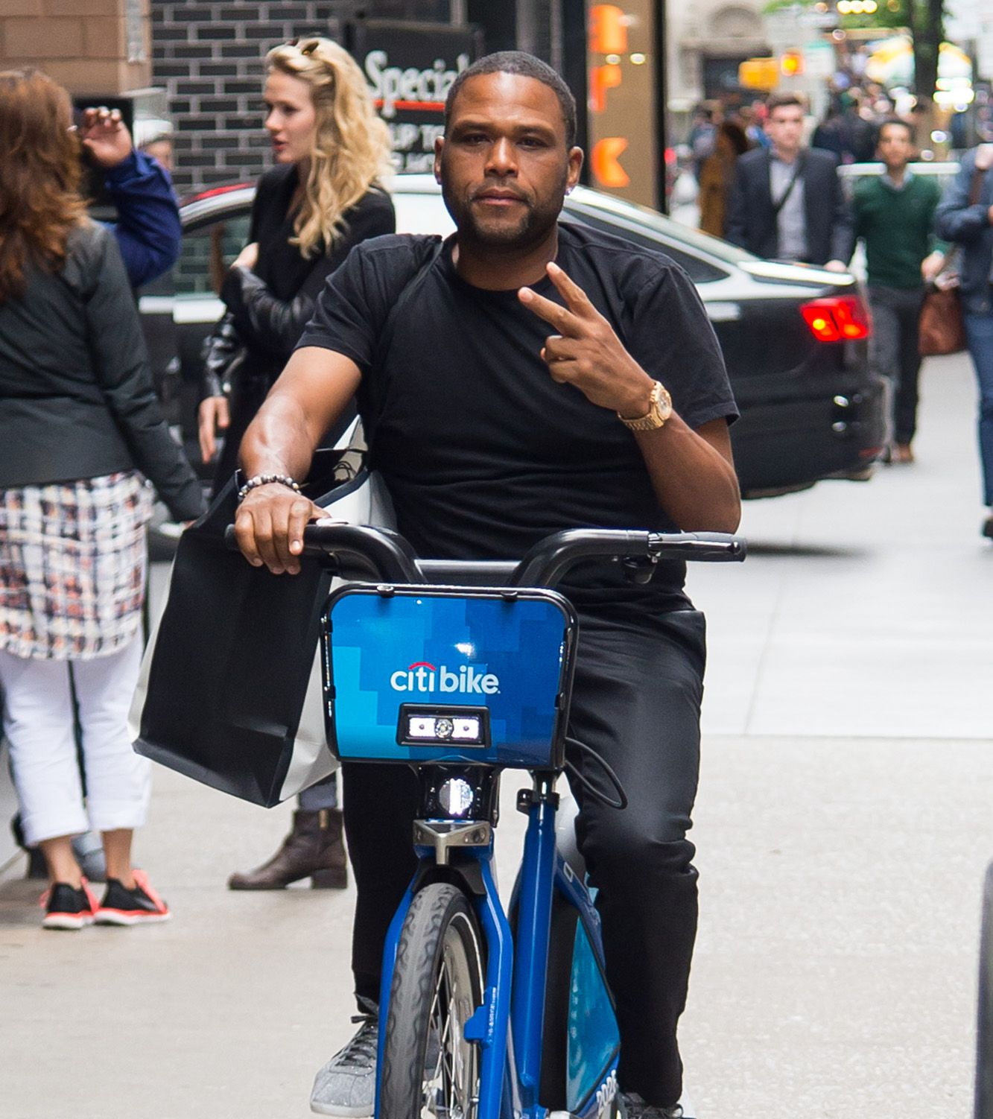
Who Exactly is Using Citi Bike?
Demographics
Generation
Age
Gender
User
Type

Slide 6

Millennials Dominate CitiBike Usage

Slide 7
Generation bike breakdown

Slide 8
Graph on gender breakdown

Slide 9

Women Ride bike for longer and more frequently

Slide 10
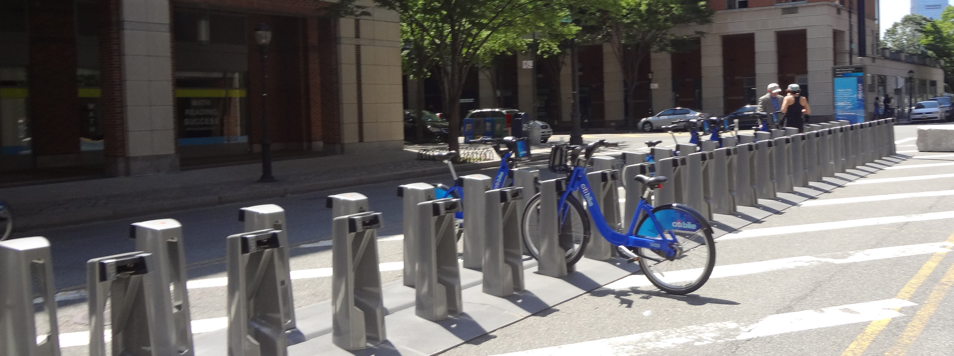
Cause: Bike Shortages in Certain Areas of the city

Slide 11
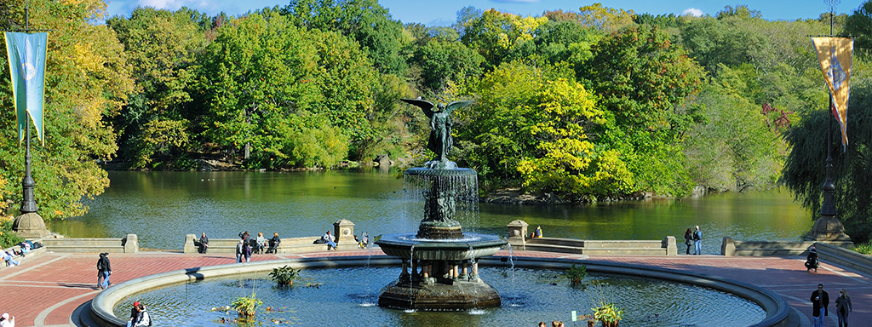
Recommendation
Redistribute bikes throughout the city during the year

Slide 12
Some type of visual on this slide showing how stations have a lot o rides going out but none going in
Creative Infographics
The Slogan of the presentation or a small tag line
75K
50K
55K
45K
45K
35K
35K
25K
30K
10K

Slide 13
Add rider speed data and popular station locations on this slide

Slide 14
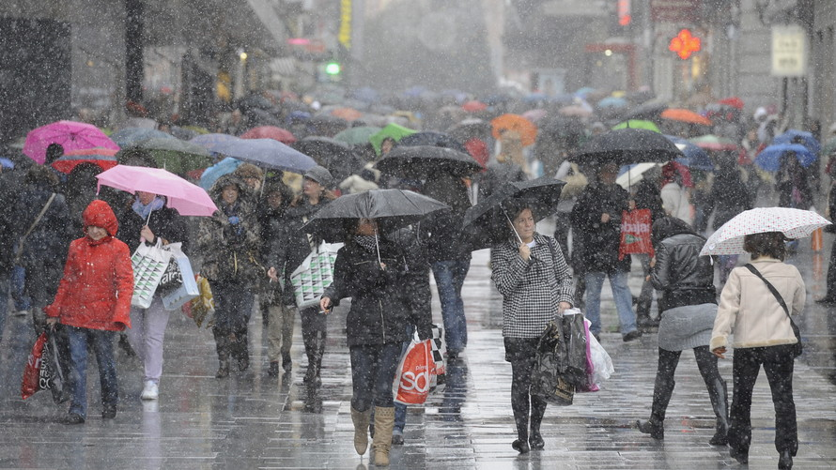

Risks

Slide 15
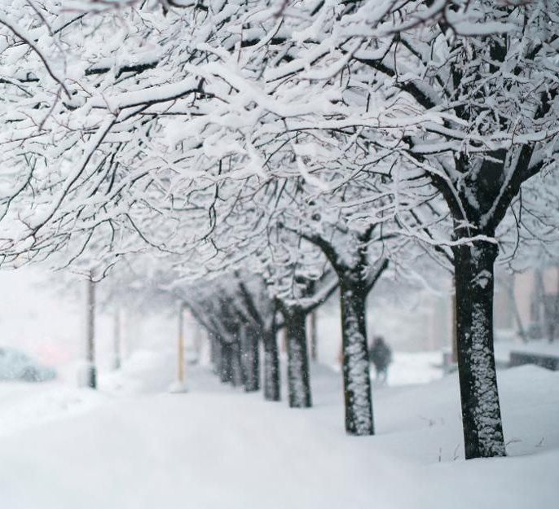
Weather slide goes here

Slide 16
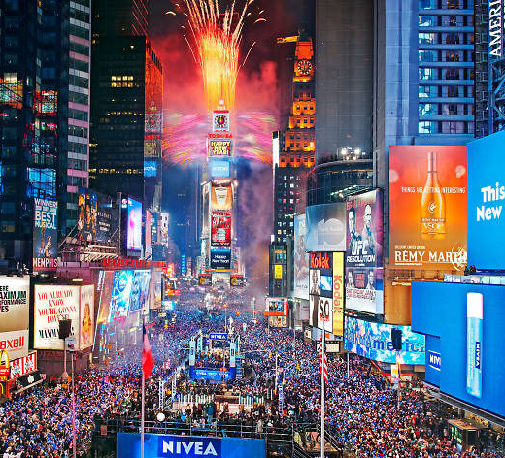
Holiday slide goes here

Slide 17
Not sure where to put the shiny

Slide 18

Questions?

